Slide 1
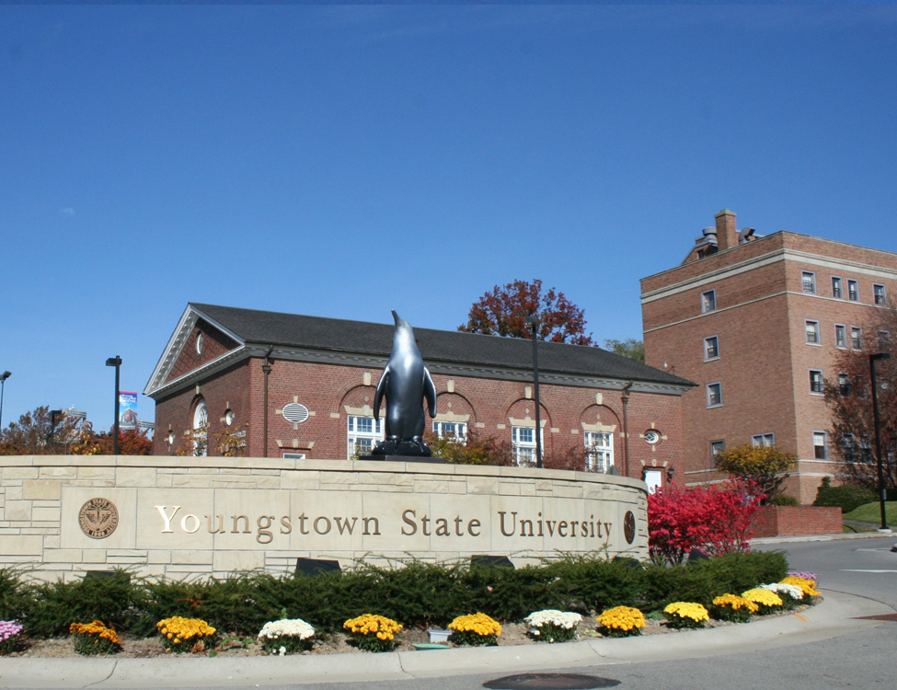


FIRST DAY® COMPLETE
An innovative course material model supporting student outcomes
through equitable access, convenience, and affordability

Slide 2
STUDENTS HAVE TOLD US
“
“
“
The process of
getting textbooks each
term can be a
HASSLE
Not having course materials at the start of the term can have a
NEGATIVE
impact on my learning
Textbooks are too
EXPENSIVE
We partnered with our Barnes & Noble bookstore to find a solution to address these issues and they developed a program that provides all students all their course materials before the first day of class at a significant savings.​

Slide 3

2023 FDC Survey Results
Youngstown State University students are in favor of this type of course material delivery model.
88 PERCENT
students that said they were interested in course material bundling*
74 PERCENT
students that said they would have a more positive perception of their school if a course material bundling model was offered*
NATIONAL IMPACT ON STUDENT OUTCOMES*
92%
said the program saved them time in shopping for course materials because they are all in one place
86%
said with this program, they were better prepared for the academic term
83%
said that the program had a positive impact on their academic success
91%
Found it convenient to have their course materials bundled and delivered through the program
83%
felt the program provided them with more affordable course materials
89%
Said they were likely to recommend the program to other students
*FDC Student Success Survey June 2023
N=3,976

Slide 4



INTRODUCING FIRST DAY® COMPLETE
A proven solution that supports student success
by ensuring students have access to all their course materials on or before the first day of class
STUDENTS
AUTOMATICALLY
receive all their books and access to electronic materials on or before the first day of class
MATERIALS ARE INCLUDED
in tuition or applied as a charge to the student account
SIGNIFICANT STRESS REDUCTION & COST SAVINGS
for students versus the traditional model

Slide 5

IMPROVING EQUITABLE ACCESS, CONVENIENCE & AFFORDABILITY AT
Youngstown State University
Full Time Student would now only spend
$345
(Based on 15 credit hours)
First Day Complete
Pricing per credit hour
$23

Slide 6
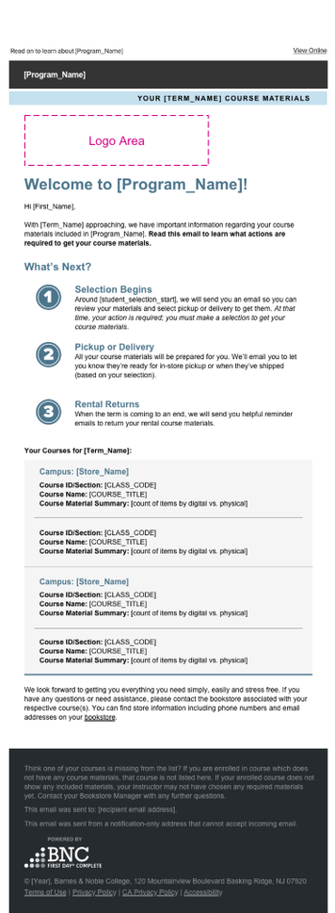
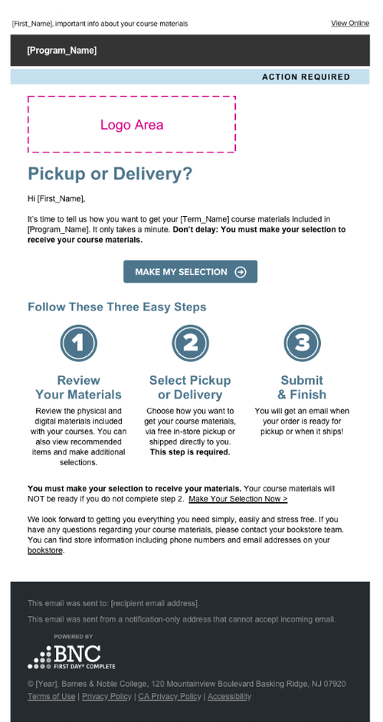
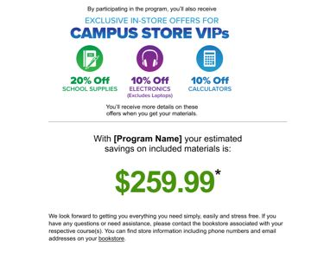
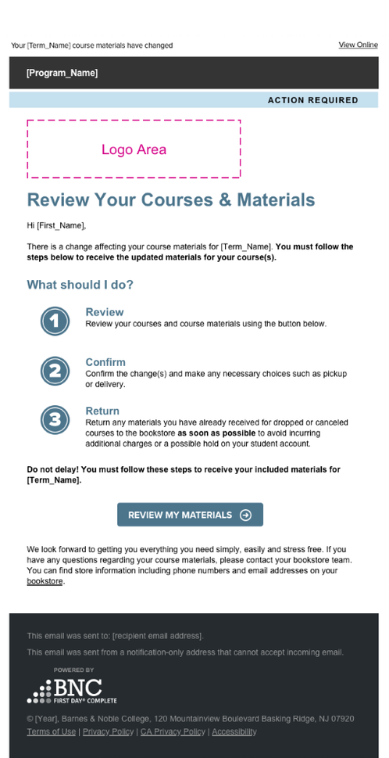
First Day Complete Student Emails
Personalized Course Material Update Emails
Welcome Email
Sent 35 days prior to the start of class
Selection Email
Sent 30 days prior to the start of class and every seven days until selection is confirmed
Course Change Email
Sent to students for course change confirmation
First Day Complete Student Experience Video
Notes:
Students participating in the First Day Complete program will receive a series of personalized email communications about their course materials included in the FDC program.
First email welcomes the student to the program, provides a list of their course materials and what they can expect next:
Step 1: Welcome: For now, you do nothing while we prepare your course materials.
Step 2: Pickup / Delivery Selection Begins: We will send you an email so you can review your materials and select pickup or delivery. Your course materials are paid for; we just need you to make a few simple choices.
Step 3: Receive Your Materials: Based on your selection, all your course materials will be prepared for you and ready for in-store pickup or delivered to your doorstep.
Step 4: Rental Returns: When the course is over, we will send you helpful reminder emails to return your rental course materials
Course materials selection email (30 days before class start date) – Students are requested to select how they would like to receive their course materials – either pick up at the bookstore or have their materials shipped to them directly.
Reminder course materials selection email (every other day) – The course materials selection email will be sent to students that have not confirmed their course materials, every other day through 14 days after the start of class or until course materials selection is confirmed.
Email confirmation when the books are ready for pickup or have been shipped.
Course Change email- when a student adds/drops a course, students are provided instructions for returning their course materials, and we provide them delivery options for any new courses that have been added.

Slide 7
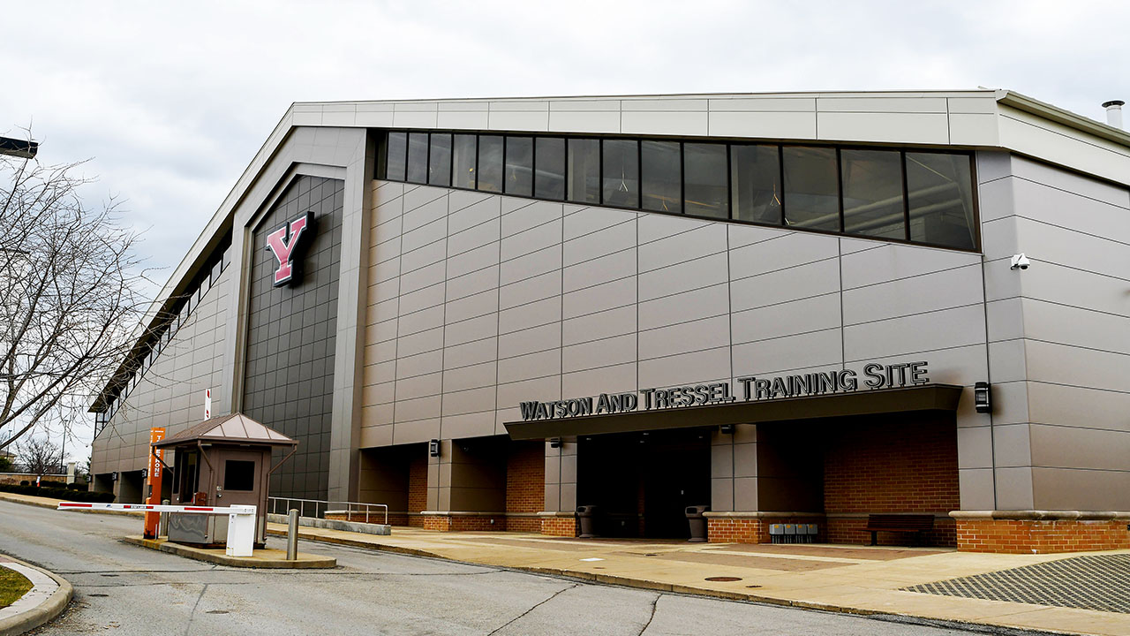
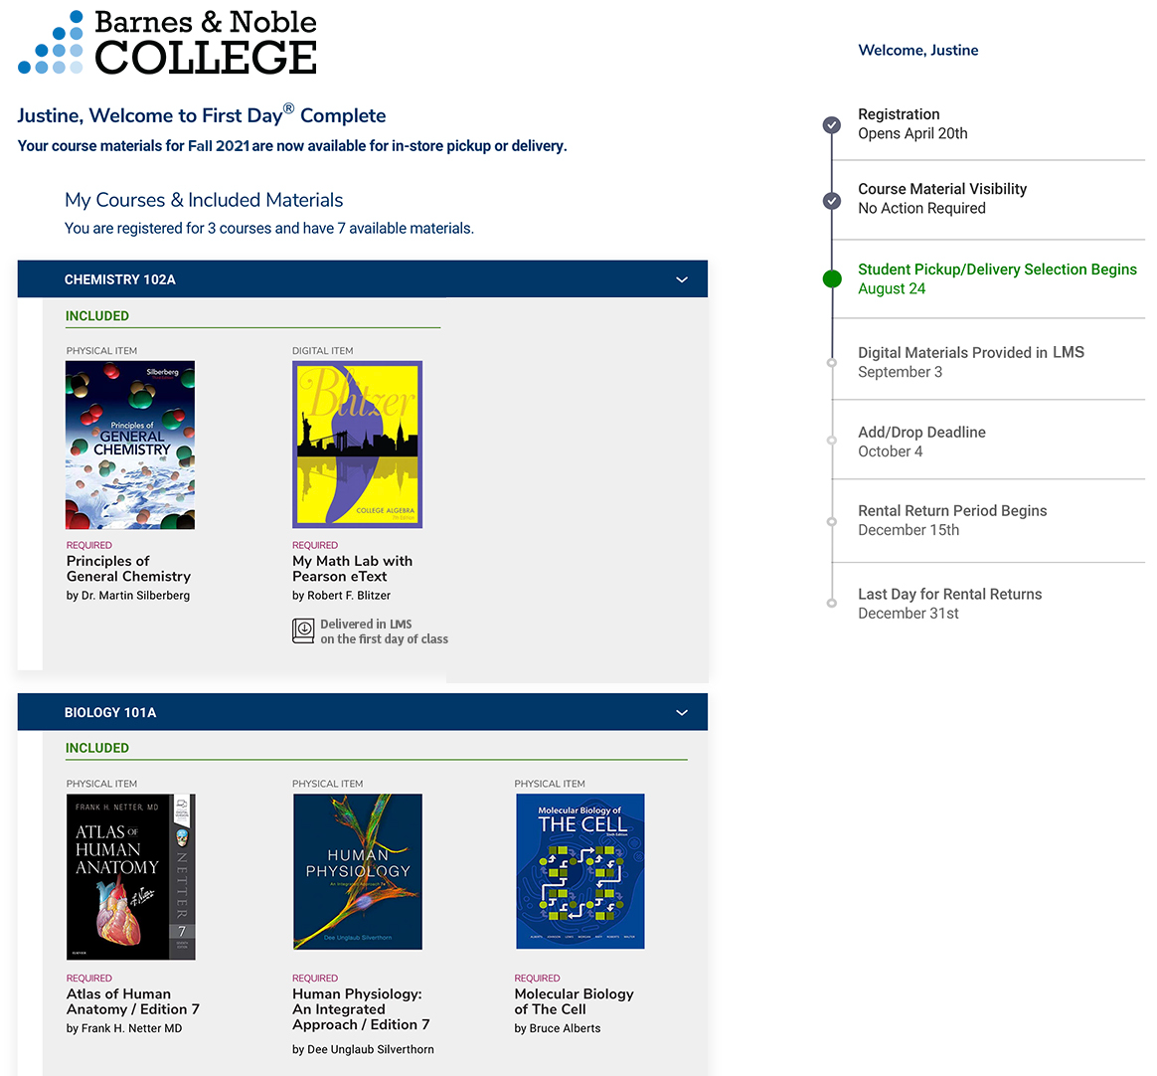
Personalized Student Experience
STEP 1 |
REGISTER FOR CLASS
VERIFY MATERIALS
STEP 2 |
STEP 3 |
SELECT FULFILLMENT METHODS
STEP 4 |
RECEIVE MATERIALS
STEP 5 |
END OF TERM:
RETURN MATERIALS

Slide 8
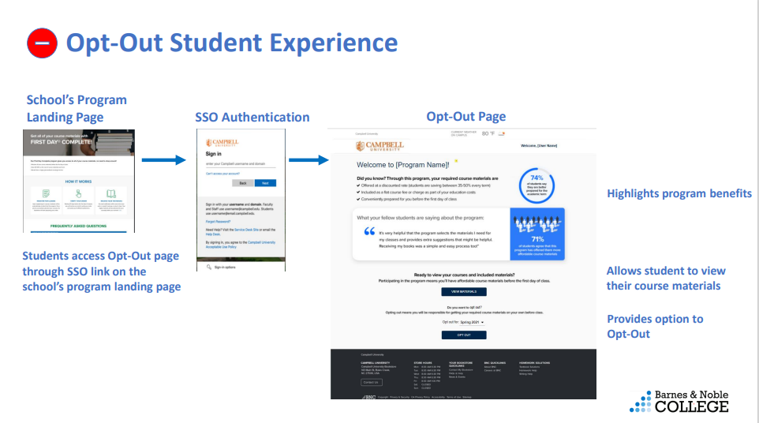
Opt out is done by semester; if a student wishes to opt out for an academic year, they must opt out each semester.

Slide 9

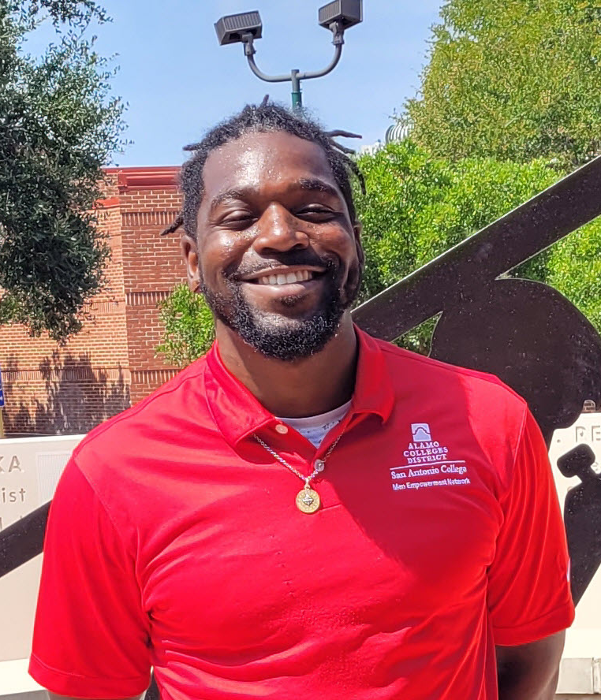
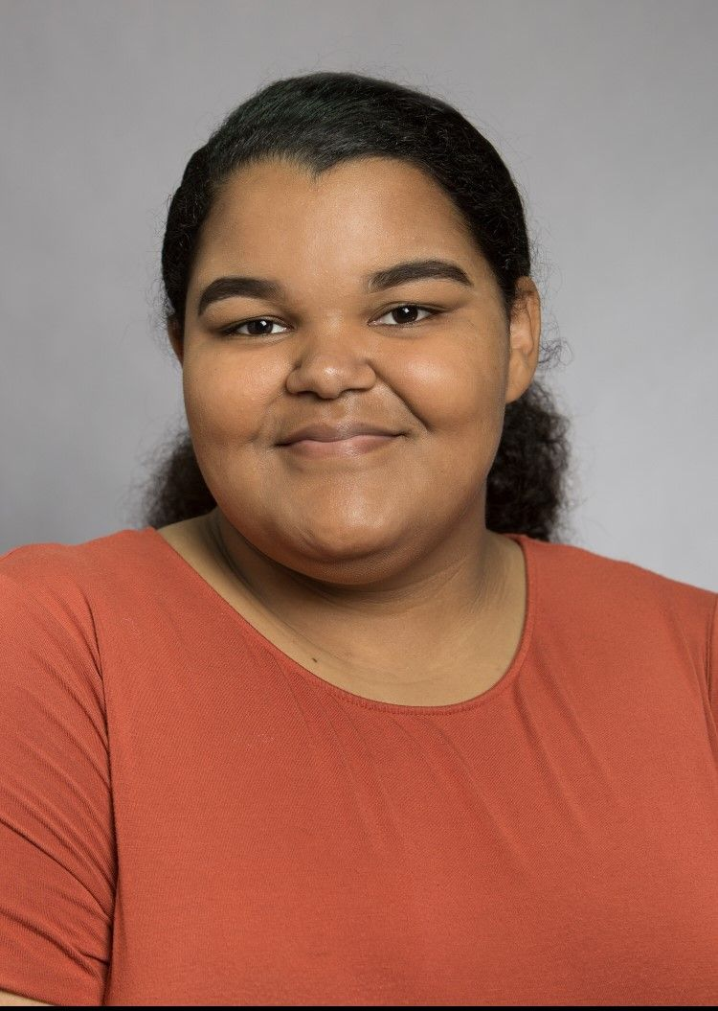
WHAT STUDENTS ARE SAYING…
“Not having to worry about books really takes a load off and is more convenient. Before this program, I didn’t have all my materials and my grades were affected.”
Jose Valesquez
Lees-McRae College
89 PERCENT
would want to participate in the program in the future
“
The program is going to help change a lot of people’s lives.
Molly McGowan
Eastern Kentucky University
”
“This program has given me the opportunity to be able to pick up my books on time and be ready for classes.”
Robert Jordan
Alamo Colleges District
83 PERCENT
reported the program had a positive impact on their academic success
63 PERCENT
said the availability of the program increased their likeliness of continuing their education at the school
“
83 PERCENT
said the program provided them more affordable course materials
“Before the program I decided not to buy the books for a class on some occasions. I definitely feel less stress now having the book at the beginning of the semester.”
Cassondra Hall
Jacksonville University
I just went online, logged in and registered, and the books are automatically synced to the classes that I was in.
Terrell Richardson
North Carolina A&T
”
Notes:
We listen to the students and faculty on your campus about the program for continued success
Review slide and highlight a few quotes

Slide 10



Slide 11
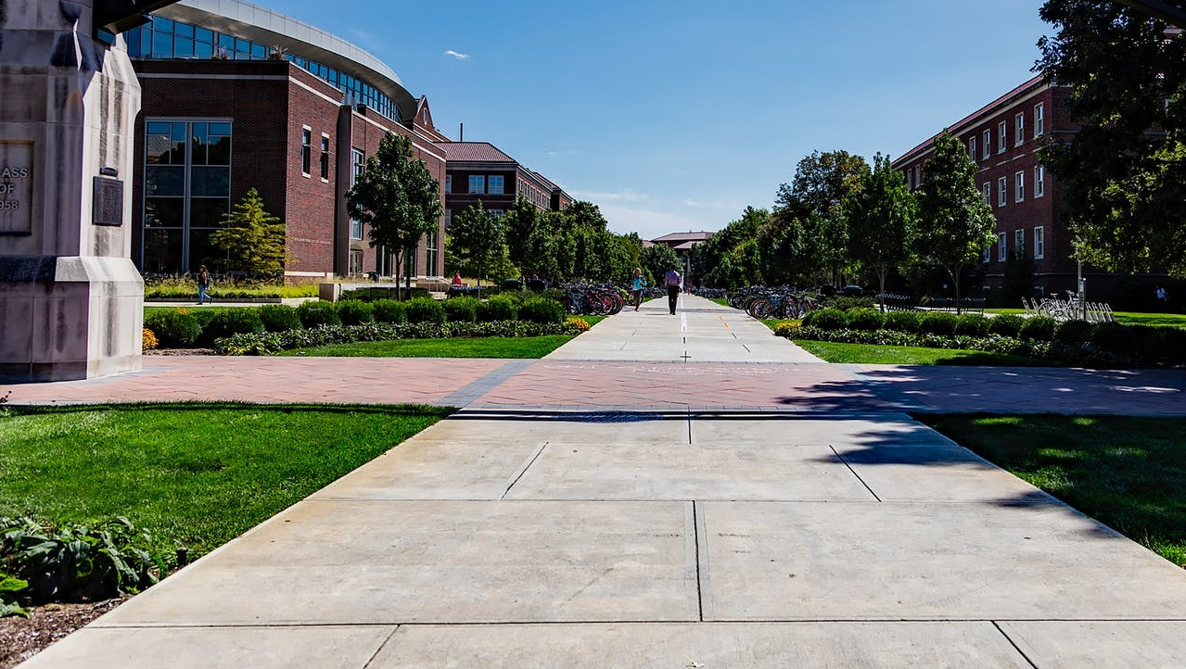
Supporting Student Success

