Slide 1

Understanding AP-Marketed Programs:
Experiences from a Large-Scale
Online Program (the OMBA)
What AP Is and Is Not
ACADEMIC PARTNERSHIPS

Slide 2
PREFACE
The information in this presentation is based solely on the experiences of the large-scale online OMBA program.
The content of this presentation should not be considered an endorsement or a denunciation of: Academic Partnerships (AP), the YSU-AP partnership, the business model of the YSU-AP partnership, or decisions related to large-scale online educational initiatives.

Slide 3
What AP Is and Does
(and Does Very Well)

Slide 4


Official Responsibilities
ACADEMIC PARTNERSHIPS
Knowledge, support and years of experience in converting programs to a high-quality online learning format
Support for the university’s efforts to streamline systems, technology and processes to optimize the student experience
Market research, sector-specific integrated strategy and employer-based relationships to align workforce relevant offerings.
Prospective student outreach
Student retention services to support students’ success as they progress through their academic program on a course-by-course basis to completion
All academic matters, including the hiring of faculty and teaching assistants, evaluation of faculty, development of curriculum and course content, grading and assessment of students, and awarding degrees and credentials
All content-related intellectual property
Student support and advisement
All admissions standards
All admissions decisions and the administration of the admissions process, including the number of applicants admitted
The amount of tuition and fees charged to students
The number of students enrolled in any given program or course
All administration, advisement and disbursement of federal student financial aid and the billing and collection of tuition and fees
All matters relating to accreditation

Slide 5
What is AP?
AP is a marketing agency.
A marketing agency focused on the attraction and retention of customers.
Focus on market-attractive products.
The key to understanding the partnership is to adopt this perspective.

Slide 6
The AP Marketing Process
(its not magic, but it is a machine)

Slide 7




Manage the Customer Sales Funnel

Slide 8
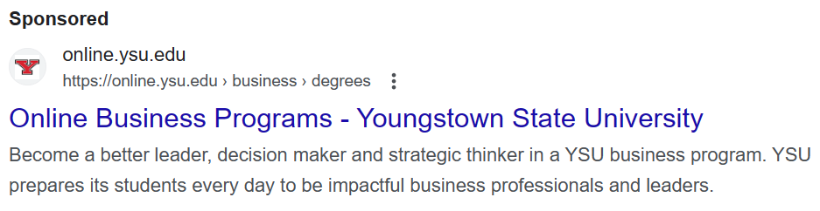
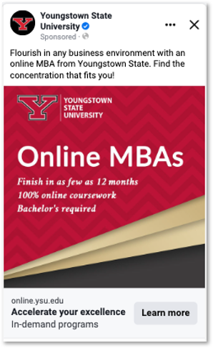
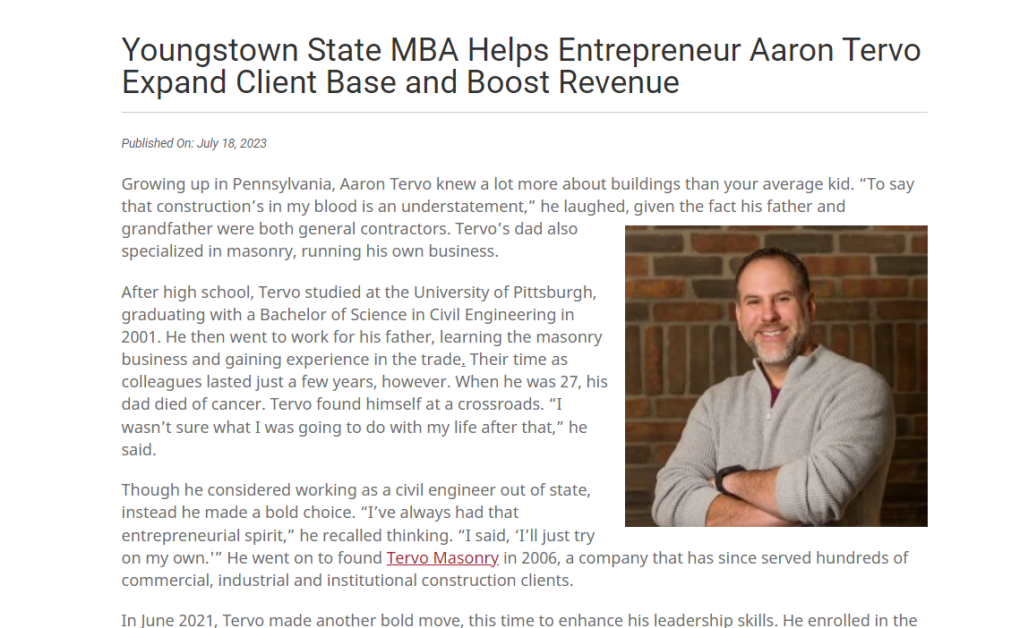
Awareness
Paid search
Display on social
  Facebook
  LinkedIn
SEO
  Articles
  LinkedIn
  Optimize YSU website

Slide 9
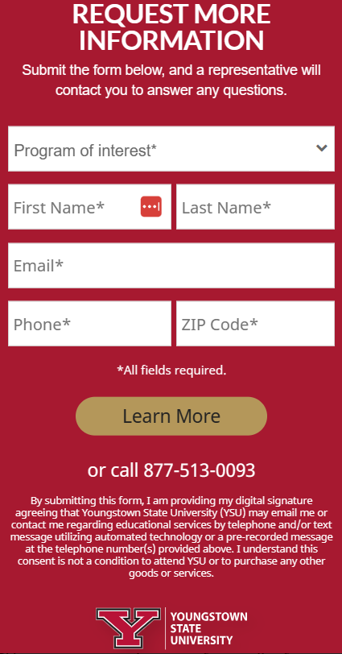
Interest & Decision
Information intake
Systematic lead management
Email prospects quickly
  6 emails on initial contact
Call prospects quickly
  7 calls in 10 days
Educate prospects on the product
Lead to start an application
Work with to complete application

Slide 10
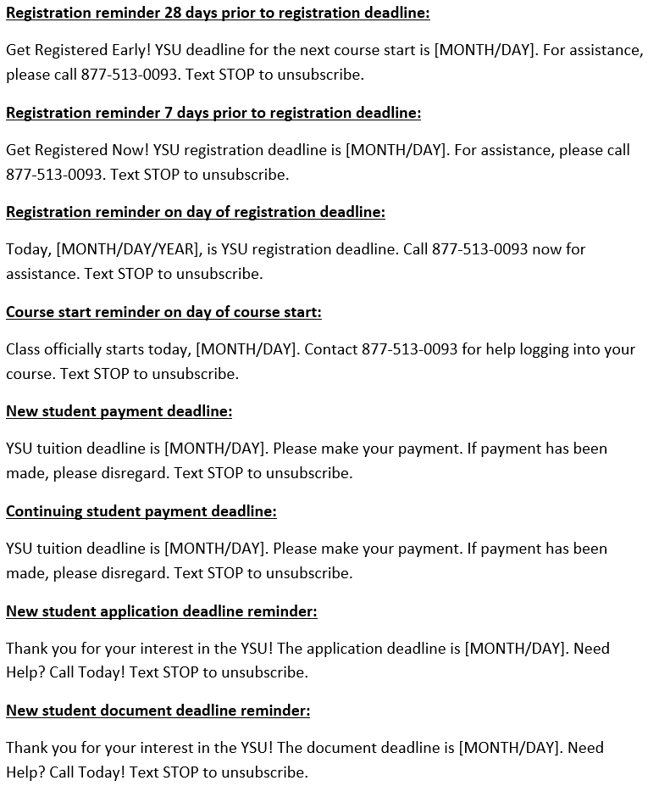
Action
Ensure students are registered after admission
Ensure students are retained
  Text reminders of registration start
  Call unregistered students
Ensure students pay on time
Key is the communication plan
  Very detailed document (88 page)

Slide 11
Cumulative Enrollment of Large-Scale OMBA Program

Slide 12
AP Does Well, Very Well
Markets
Recruits
Retains

Slide 13
The Gray Area
AP Does Somethings, But Not Everything

Slide 14
Provide Product (Program) Guidance
AP Will Make Suggestions On
Suggested Actions
Program selection
Program names
Course names
Prerequisites
Admission criteria
Avoid reflexively saying no
Do not just do what is said
Try to listen for the purpose
Expect a little pressure
Determine what is important – do that

Slide 15
Instructional Design
Not simply adapting an existing course
Methodological process:
  Identify course learning objectives
  Identify module learning objectives
  Map module LOs to course
  Ensure assignments aligned with module LOs
Facilitates:
  Getting content into Blackboard
  Making accessible for ADA compliance
Suggest if course could be more interactive (but not how to)
Quality Matters review – a minimum baseline
Identify appropriate forms of content for online learners
Equipment and/or facilities to create engaging online learning content
Technical support to create content
  Recording video & audio
  Editing video & audio
Ongoing development support
Bb Ultra support for faculty
  All IDDC – 3 people total for any course that uses Bb Ultra (conversion coming)
ACADEMIC PARTNERSHIPS
Need both parts to actually have a course.

Slide 16
What AP Does Not Do and YSU Must
(underestimated and underinvested)

Slide 17
If Your Takeaway Nothing Else…
Campus students taking some online courses
is very different than
Online students taking all online courses

Slide 18
Advising, Advising, Advising
OMBA – most simple model, still challenging
Program Structure
  10 courses (8 core + 2 specialization)
  All students need 10 courses
  Completion plans in place
  Predictable schedule
  All courses offered from same program/college – facilitates coordination
  Primary advisor – only point of contact
Operational Challenges
  Students may not follow the rotation (work, life, or just chose not to)
  Not a lot of flexibility – schedule is fixed
  Adding a class after course start (late) is problematic
  8 to 5 advising model does not work
  Transfer credit evaluations (9 credit max)
Undergraduate is much more complex than OMBA
Program Structure
  40 courses (varied)
  Completer students need unknown number of courses
  Cannot predict courses students will need
  Offerings may vary
  Programs offered by various programs/colleges
Operational Challenges
  No clear primary point of contact for students
  Evaluation of transfer credits (up to 90 max)
  Late ads to class are problematic (late = after course start)
  Advisors need to be available virtually
  Advisors need to be available nights & weekends

Slide 19
What Will Be Overlooked, But Cannot Be
Support for Student Success
Operational & Academic
24/7 technical & Bb Ultra support for students
Availability of courses
  Number of accelerated courses
Scheduling
  Courses balanced across sessions
Confusion of scheduling, made worse by new system
  Hard to find and selecting 7-week course vs 16-week
Communicating information
  Program, college, and university
Communication gaps
  AP will be communicating (very well) to only some students (25+)
Online orientation needed for everything
Career management
Managing Virtual Assistants
Managing Virtual Assistants
Managing Virtual Assistants
Every single support function – stretched & tested
Processing of applications – very short staffed
  AP requires very fast turnaround
Communicating with all students
24/7 technical & Bb Ultra support for faculty
Equivalence of programs – accredited programs
Program assessment for accreditations
Academic integrity concerns

Slide 20
So, That’s One Perspective

Slide 21
Logistical Guidance
Course Rotation (or Carrousel)
Operational
Set sequence of course offerings
The key ingredient for efficiency
  Facilitates timely completion of degree
  Facilitates advising
To work it needs:
  Active input from the program
  Program with set requirements
  Programs with limited courses (~10)
Not possible for completer UG programs
  Too many variable requirements to predict
  Too many courses to maps
Best outcome is a committed schedule
Analysis to streamline processes
Suggestions to improve systems
They can facilitate improvements
  Work through AP to help create desired changes

