Slide 1
NSSE 2023 Senate Highlights
NATIONAL SURVEY OF STUDENT ENGAGEMENT
Institute for Teaching & Learning

Slide 2
What does the NSSE Measure?
STUDENT ENGAGEMENT
Educationally effective institutions channel student energy toward the right activities
Survey Content
Engagement in meaningful academic experiences
Student reactions to college
Engagement in high impact practices
Student background information
WHAT STUDENTS DO
Time & energy devoted to educationally purposeful activities
WHAT YSU DOES
Using resources and educational practices to encourage students to do the right things

Slide 3
About the NSSE
Launched in 1999 and updated in 2013
YSU strategically administers the NSSE
2010, 2013, 2016, 2018, 2021, & 2023
Wide participation across North America
Since 2000: Nearly 1,700 institutions & 6 million students have participated
In 2023: 541 Institutions & 354,067 students responded to the survey

Slide 4
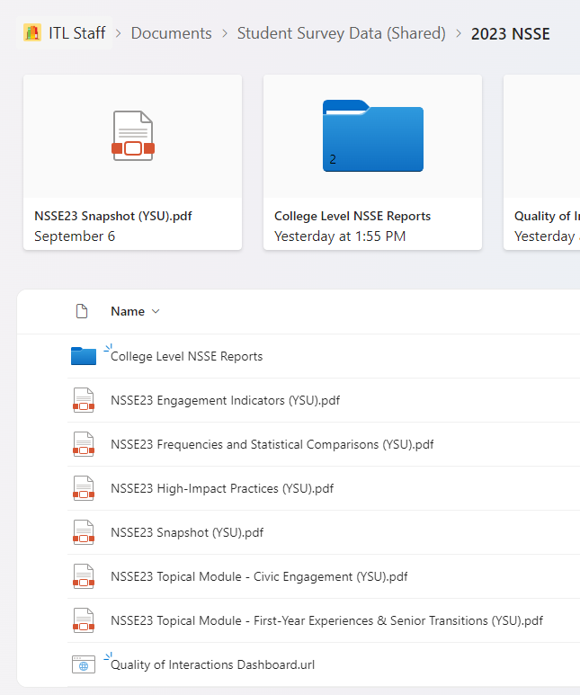
Survey Administration
All active first-year and senior students
Spring 2023
Web-based survey
Incentives & reminder emails
Topical Modules: (add on)
First-Year Experiences/Senior Transitions
Civic Engagement
View module data with your YSU credentials at ysu.edu/yourvoicematters.

Slide 5
Data Quality
21% first-year student response rate (386) – margin of error +/- 4.4%
20% senior student response rate (368) – margin of error +/- 4.6%
View a full respondent profile with your YSU credentials at ysu.edu/yourvoicematters.

Slide 6
Academic Challenge
Higher-Order Learning
Reflective & Integrative Learning
Learning with Peers
Collaborative Learning
Discussions with Diverse Others
Experiences with Faculty
Student-Faculty Interactions
Effective Teaching Practices
Learning Strategies
Quantitative Reasoning
Campus Environment
Quality of Interactions
Supportive Environment

Slide 7
For each Engagement Indicator (EI):
Multi-year trends
100% of EI means increased from 2021 to 2023
70% of EI means increased since 2018

Slide 8
Theme: Academic Challenge
 |  | Trend Since 2018 | Trend Since 2021
First-Year | Higher-Order Learning | ↓ 0.2 | ↑ 1.1
 | Reflective & Integrative Learning | ↑ 1.0 | ↑ 1.5
 | Learning Strategies | ↑ 1.2 | ↑ 1.4
 | Quantitative Reasoning | ↑ 1.7 | ↑ 3.3
 |  | Trend Since 2018 | Trend Since 2021
Senior | Higher-Order Learning | ↑ 0.9 | ↑ 0.6
 | Reflective & Integrative Learning | ↑ 1.6 | ↑ 0.8
 | Learning Strategies | ↑ 1.6 | ↑ 0.6
 | Quantitative Reasoning | ↑ 3.5 | ↑ 1.6
Trends are descriptive with no statistically significant results currently presented.

Slide 9
The content taught in courses, specifically in my major, is outdated. A lot of the work I am doing at my internship I had to learn, and very little knowledge carried over from coursework to the internship. The college needs to do a better job of staying up to date with evolving trends within the workplace.

Slide 10
Theme: Learning with Peers
 |  | Trend Since 2018 | Trend Since 2021
First-Year | Collaborative Learning | ↑ 0.4 | ↑ 5.9
 | Discussions with Diverse Others | ↑ 2.4 | ↑ 6.1
 |  | Trend Since 2018 | Trend Since 2021
Senior | Collaborative Learning | ↑ 0.4 | ↑ 2.7
 | Discussions with Diverse Others | ↑ 0.2 | ↑ 1.9
Trends are descriptive with no statistically significant results currently presented.
Notes:
Expect to see big gains, because remote in 2021, but even saw improvement since 18

Slide 11
I think the greatest experience earned from discussions is trying to understand all points of view, even if they differ from your own. By civilly discussing an issue, it's very possible to learn more information on the topic and possibly change your previous opinion.

Slide 12
Theme: Experience with Faculty
 |  | Trend Since 2018 | Trend Since 2021
First-Year | Student-Faculty Interaction | ↑ 4.1 | ↑ 0.7
 | Effective Teaching Practices | ↑ 0.6 | ↑ 1.0
 |  | Trend Since 2018 | Trend Since 2021
Senior | Student-Faculty Interaction | ↑ 1.2 | ↑ 2.2
 | Effective Teaching Practices | ↑ 2.7 | ↑ 4.3
Trends are descriptive with no statistically significant results currently presented.
Notes:
Less of you, but students still having good experiences

Slide 13
Since I'm a first-generation college student with one parent, I think my professors guided and developed me academically. I feel very confident in myself and finding a future career.

Slide 14
Theme: Campus Environment
 |  | Trend Since 2018 | Trend Since 2021
First-Year | Quality of Interactions | ↑ 2.5 | ↑ 1.5
 | Supportive Environment | ↓ 0.1 | ↑ 4.8
 |  | Trend Since 2018 | Trend Since 2021
Senior | Quality of Interactions | ↓ 0.1 | ↑ 0.9
 | Supportive Environment | ↑ 2.7 | ↑ 2.3
Trends are descriptive with no statistically significant results currently presented.
Notes:
FY: quality of interactions, improvements in advising relationships

Slide 15
My time at YSU provided me with a safe place to create work and make friends from different background, getting a job on campus introduced me to a whole new side of YSU as a commuter, I have a new found appreciation for campus life and community building.

Slide 16
Next Steps:
Join ITL for the next sessions of the NSSE Lunch & Learn Series (Lunch is provided)
Campus & Community Engagement, 3/27, 12-1pm
Student Experience w/Faculty, 4/10, 12-1pm
Learning w/Peers, 4/24, 12-1pm
Access data online: ysu.edu/yourvoicematters
Overview webinar
Summary reports
College level reports (accessed w/YSU credentials)
Can request program- or department-level data

