Slide 1

Academic Senate Technology Committee Update
IT Projects 2024

Slide 2
IT Projects 2024
Banner Self Service: Faculty Grade Entry (Registrar) – February
Banner Self Service: Finance (General Accounting) – February
New Penguin Portal (IT) – February
Ultra – Blackboard (Bb) Course Shells (Cyberlearning/IT) - Fall
Notes:
Project Name, Department/Partner, Month or Term for Implementation
Faculty Grade Entry (Registrar) - February
New Penguin Portal (IT) - February
Links will be changed.
Legacy Penguin Portal is going out of support by vendor, 2024.
Ultra – Blackboard (Bb) Course (Cyberlearning) - Fall
All course shells will be delivered in Ultra.
Integrating grades for the Fall Semester into SSB.

Slide 3
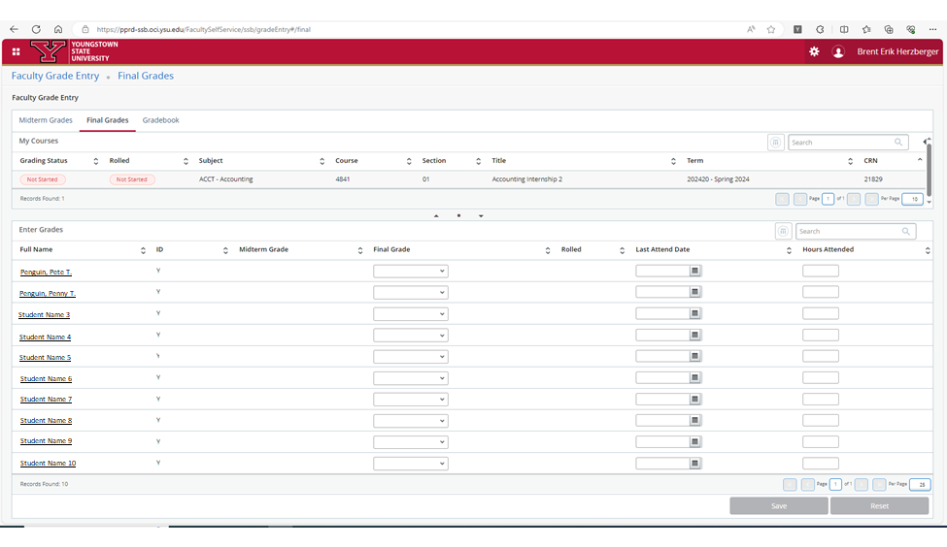
Faculty Grade Entry

Slide 4
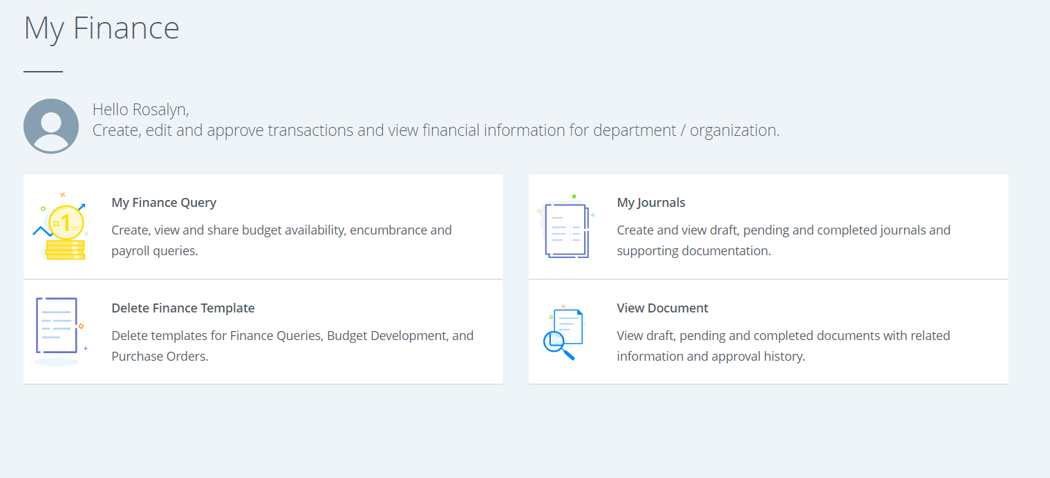
My Finance Dashboard

Slide 5
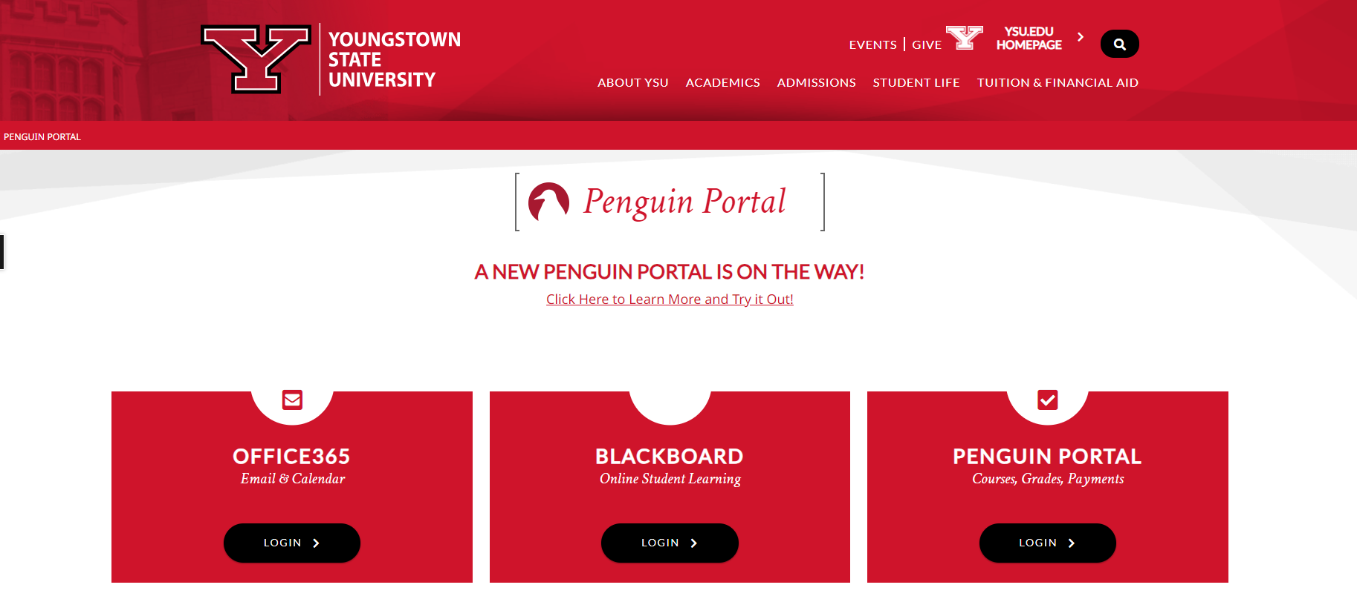
Penguin Portal

Slide 6
Penguin Portal

Slide 7
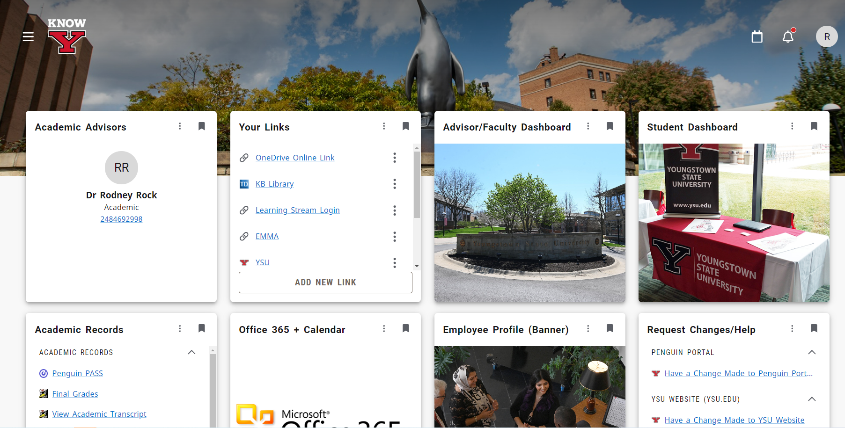
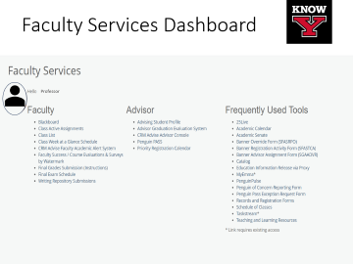

Slide 8
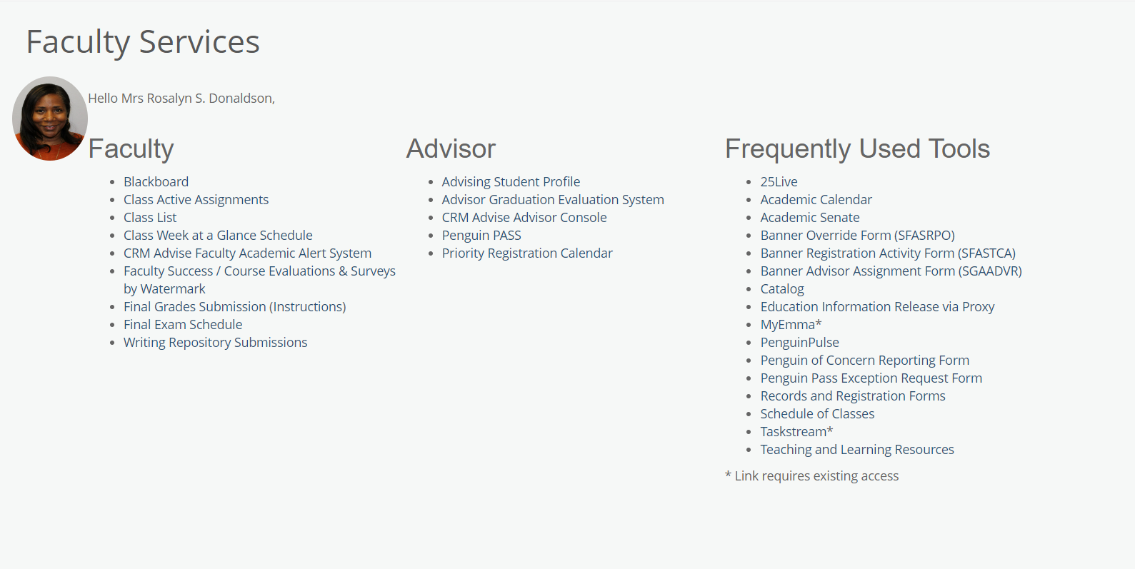

Faculty Services Dashboard
Professor
Notes:
Menu of items most frequently used by Faculty.

Slide 9
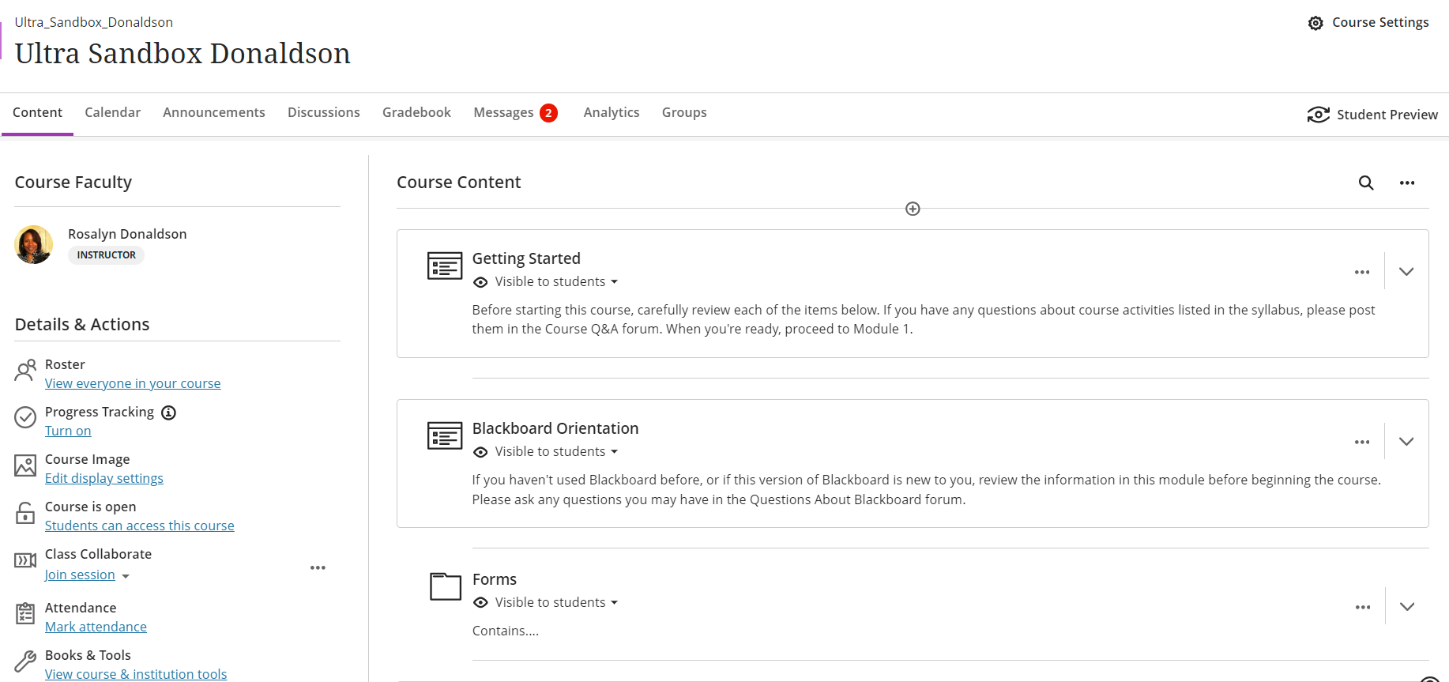
Blackboard Ultra Shell*
All Courses
* Please contact the IDDC for assistance with conversion or attend a
workshop presented by Cyberlearning.
Notes:
All course shells for Fall Semester will be delivered to you in Ultra. There will be no more Original Blackboard course shells.
Please contact Cyberlearning for support in learning and converting your fall courses to Ultra.

Slide 10
IT Projects 2024
Watermark: Faculty Success Workflows (Provost) – Spring
  Distinguished Professorship Awards - February
  Chair Evaluation of Faculty Performance – March
Faculty Leave Reporting (CBA) – Spring
Windows 11 (IT) – Summer / Fall
Gmail Risk Mitigation (Provost / IT) – Fall *
  Gmail / Drive restricted on YSU owned devices
  Exception process being developed which will require approval from Provost.
* Discovery meetings and survey in progress.
Notes:
Watermark: Faculty Success Workflows for DPA and Chair Evals are coming soon.
Faculty Leave Reporting began in January and are in accordance with the Collective Bargaining Agreement
Windows 11 will be rolled out to University Labs at the end of the Spring Semester and then other YSU devices by the end of the Fall.
GMAIL Risk Mitigation – Meetings and discussions have begun. Restricted use of Gmail and Google Drive on University devices. Exception process will be available. Jim Yukech will discuss this at a future meeting. Students using their personal devices will not be affected.

Slide 11
Projects on the Horizon
Faculty Grade Entry Upgrade
  Automated posting from Blackboard Ultra to Self Service Banner Grade Entry.
Penguin Intelligence
  WebFOCUS Reports will sunset.
DegreeWorks Student Educational Planner (Registrar)
New Specialized Engineering App Cloud (STEM / IT)
Notes:
Please share input with your ASTC members for discussion. We will come back and discuss this with you when we have more of a timeline for these projects.

Slide 12
Past Projects

Slide 13

2023 Projects
Banner Self Service Class List (Registrar / IT)
  Roster Photos – Spring
Watermark - Faculty Success Activities (Provost/HR) - Spring
  CV of record should appear in Watermark (Article 16.3)
Watermark - Faculty Success Workflows (Provost/HR)
  Intent to Apply (FIL / Research Professorship) – Fall
  Promotion & Tenure Review - Fall
YMES Sunsets (IT)
  Focus Groups on utilization. – Summer / Fall
  Select functionality moved to EMMA. – Fall
Banner Self-Service Finance Upgrade (General Accounting)
  Implemented in Fall Semester. Older version sunsets on 2/28/24.
Banner Self-Service Faculty Dashboard (Registrar / IT ) – Fall
Banner Self-Service Faculty Load and Compensation (Provost/ HR)
Acknowledge Assignment in the Employee Profile (PTF) – Fall

Slide 14
2022 Projects
Webex Classrooms (IT/Provost) – Spring /Summer
Digital Transformation Project (IT)
  Data Security / Integrity
    Y Drive to OneDrive - Fall
    Department Shares to Teams – Fall
Watermark: Course Evaluations & Surveys (Provost/HR) – Fall
  Replaced Course Evals

Slide 15


