Slide 1


title
Office of University Bursar

Slide 2


Office of University Bursar
Discussion Points:
Tuition and Estimator
Billing Statements
Authorized Users
Payment Options
Refunds
Tuition Refund Policy

Slide 3
Office of University Bursar
What we do:
The Office of University Bursar is responsible for billing of student and non-student accounts and payment processing functions.
Location: Meshel Hall, Room 227 / Telephone No: 330-941-3133 / Email: accounts@ysu.edu / Hours: Monday through Friday, from 8:00 a.m. – 5:00 p.m.
University Registrar
Financial Aid
University Bursar
Created 4/9/18

Slide 4
Office of University Bursar
How much will it cost?
Penguin Tuition Promise: fixed tuition (Instructional and General) rate for the pursuit of an undergraduate degree.
Tuition rate is established based on initial enrollment.
Encourages students to complete degree within 12 consecutive semesters.
Makes cost predictable and affordable.
Find the Frequently Asked Questions and Tuition Estimator on YSU.edu

Slide 5
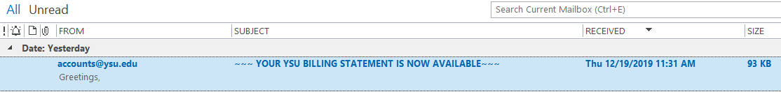
Office of University Bursar
Where is my bill?
Student accounts are billed one month prior to the start of semester.
Payment in full is due one week prior to the start of semester.
Billing notifications are sent to the student’s YSU email address.
Billing statements are not mailed; emails comes from accounts@ysu.edu.
Parents may receive billing notifications via the Authorized User option.

Slide 6
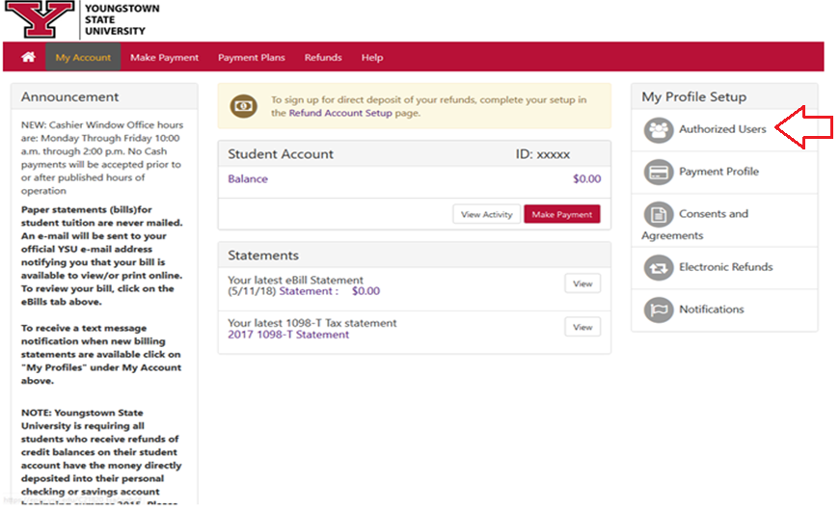
Office of University Bursar
Student Penguin Portal: www.ysu.edu/viewmybill

Slide 7
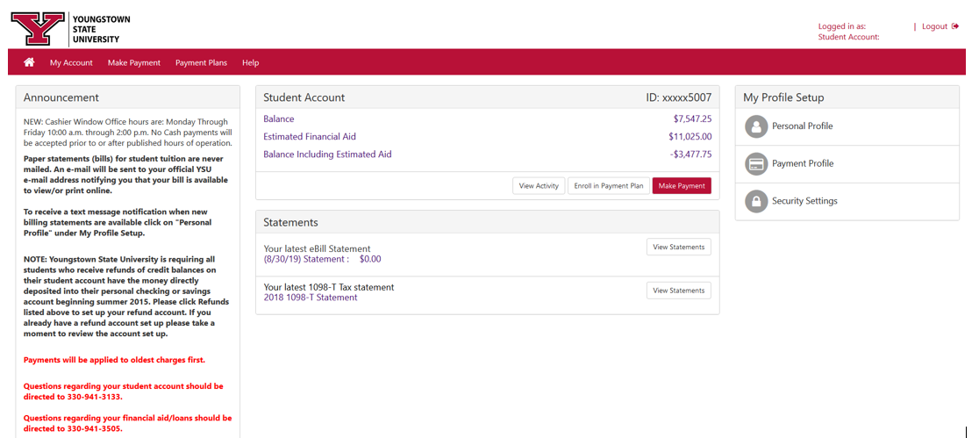
Office of University Bursar
Authorized User Portal: https://epay.ysu.edu/C21820_tsa/web/login.jsp

Slide 8
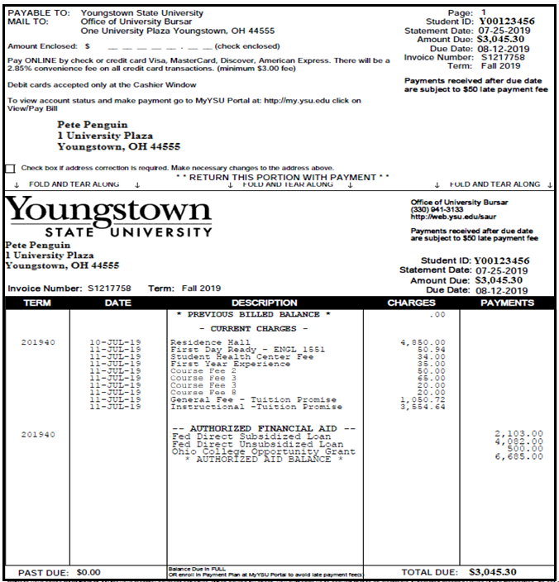
Office of University Bursar

Slide 9
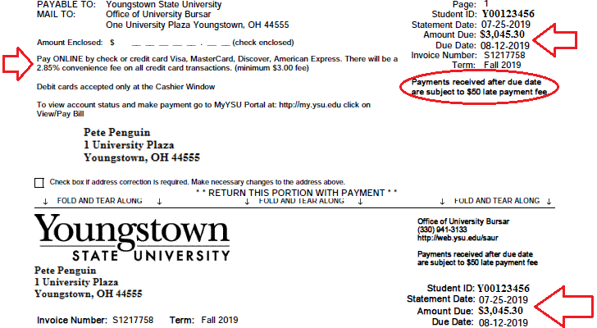

Office of University Bursar

Slide 10
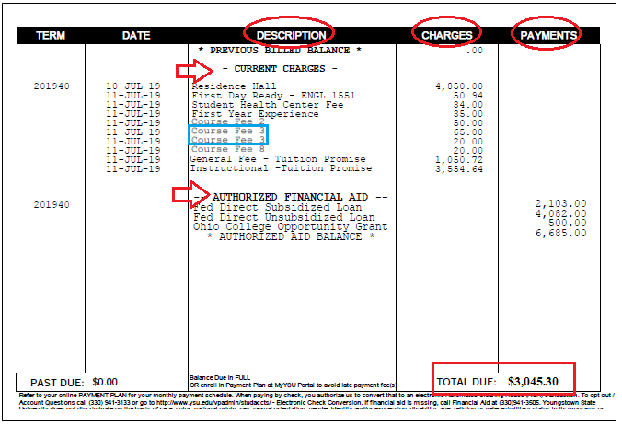
Office of University Bursar

Slide 11
Office of University Bursar
How do I avoid late fees?
Pay the balance in full by the due date listed on your bill.
If unable to pay in full by the due date, enroll in a Payment Plan on or before the due date.
Late fees ($50.00) are assessed monthly for unpaid balances.
NOTE: Keep an eye on billing notifications emailed that may arrive after the bill has been paid (i.e. parking pass, course modifications, meal plans, withdraws, etc.)

Slide 12
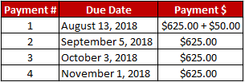
Office of University Bursar
How does the Payment Plan work?
Monthly payments are based on the total account balance divided by the number of remaining due dates for the semester (either four, three, or two).
There is a $50.00 enrollment fee due with the first payment.
You may enroll in a Payment Plan online through the YSU Bill Payment Suite via YSU Portal or the Authorized Parent User Access.
  Example - $2,500.00
  *Summer balances can be divided into 3 payments (depending on when the student registers)*

Slide 13
Office of University Bursar
How do I pay my bill?
Online through the YSU Bill Payment Suite via YSU Portal or the Authorized Parent User Access).
  Web checks: FREE of charge
  Debit/credit card (2.85% convenience fee)
Cashier Window
  Meshel Hall, Room 227
  Open 10 a.m. until 2 p.m.
  Cash, checks, money orders, debit cards
Mail
  Make checks/money orders out to Youngstown State University
  Add the Student ID Number (Y00#) to the memo section
  Mailing address is listed on the bill

Slide 14

Office of University Bursar
What is a tuition refund?
Refunds generate when financial aid awards exceed the cost.
YSU encourages all students to enroll into our direct deposit program through their Penguin Portal.
  Step-by-step instructions are available online via Sign Up for Direct Deposit.
Students also can visit the Bursar’s Office in Meshel Hall, Room 227, for one on one assistance.
Students can expect to receive refund process confirmations via their YSU email address.

Slide 15
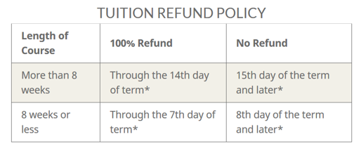
Office of University Bursar
What is the policy for course withdrawals?
Students must formally withdraw to receive 100% tuition refund, per the Tuition Refund Policy.
Students who do not formally withdraw in accordance with policy remain financially responsible for semester fees and charges.
Students must complete official withdrawal processes through their YSU Portal and should verify process completed successfully.
Withdrawing Financial Aid recipients should consult a Financial Aid Counselor to assess impacts of withdrawal on awarded Financial Aid.
The Last Day Withdraw for a 100% Refund and the Last Day to Withdraw with a “W” (a grade of “W”) are not the same.

Slide 16
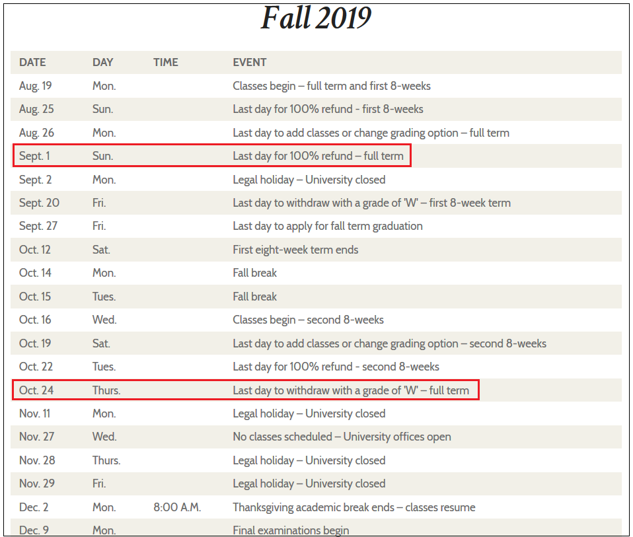
title

Slide 17
Office of University Bursar
Web Links:
Penguin Promise FAQ:
  http://www.ysu.edu/ysu-penguin-tuition-promise/frequently-asked-questions
Tuition Estimator:
  http://cfweb.cc.ysu.edu/finaid/tuition/est_tuition.cfm
Payment Plan:
  https://cms.ysu.edu/administrative-offices/penguin-service-center/enroll-payment-plan
MyYSU Student Portal:
  www.ysu.edu/viewmybill
Tuition Refund Policy:
  https://cms.ysu.edu/administrative-offices/university-bursar/tuition-refund-policy
Direct Deposit:
  http://cms.ysu.edu/administrative-offices/penguin-service-center/sign-direct-deposit
University Bursar:
  http://cms.ysu.edu/administrative-offices/university-bursar/university-bursar
Power Point Presentation:
  https://ysu.edu/sites/default/files/bursar/Orientation%20PPT.pptx

Slide 18

Office of University Bursar
Questions?

Slide 19

title

