Slide 1
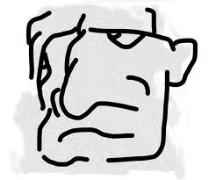
Tips for Dealing with Challenging Student Behavior
Jake J. Protivnak, Ph.D., Associate Professor / Chair, Department of Counseling, Special Education, & School Psychology, YSU
Matthew J. Paylo, Ph.D., Assistant Professor / Counseling Program Director, Student Affairs & College Counseling Program Coordinator, YSU
Kyoung Mi Choi, Ph.D., Assistant Professor, Department of Counseling, Special Education, & School Psychology, YSU

Slide 2
Discussion Overview
Discuss examples presented by attendees. Provide suggestions regarding behaviors that could be grouped into either:
  Personal/Social (e.g., class disruptive, passive-aggressive, mental health related-issues, etc.) issues that instructors may need to address.
  Academic (e.g., frustration associated with lack knowledge/skills/support needed for course, etc.) or
Examples…

Slide 3
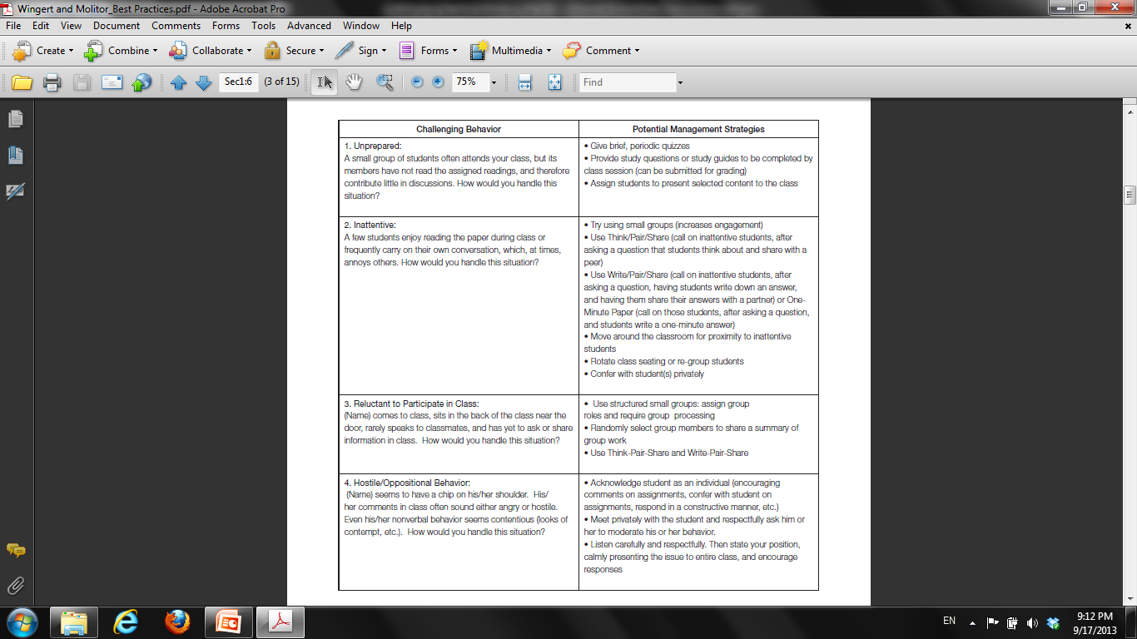

Slide 5
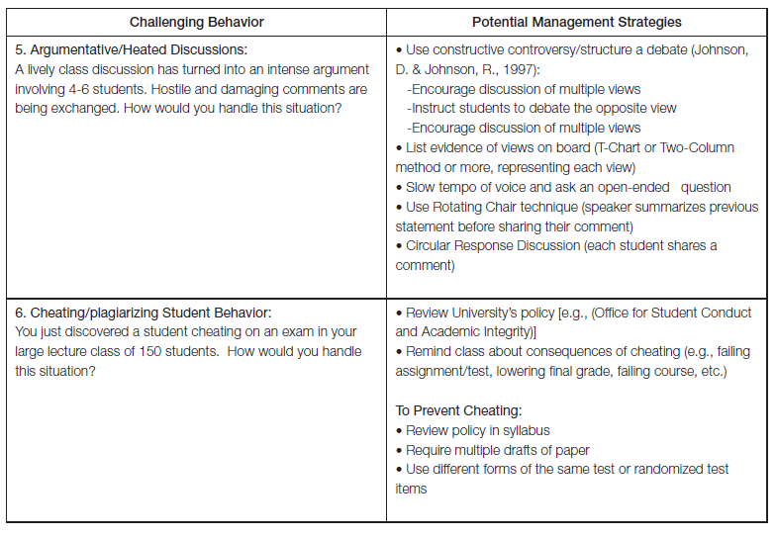
Wingert & Molitor, 2009

Slide 6
Describing The Problem Clearly
What is the behavior?
When does it happen?
What is going on before, during, and after the behavior?
Who is involved?
Is the behavior harmful to the student, you, others?
How do you feel about the behavior?
What changes would make the behavior or situation acceptable?
What did you do / did it work?
Kuhlenschmidt & Layne, 1999

Slide 7
Understanding Reasons for Behavior
Physical Causes
  Medication, Drugs, & Other Substances; Illness; Fatigue; Discomfort; Vision/hearing problems
Emotional Challenges
  Loss/Grief; Immaturity; Attention Seeking; Misdirected Aggression
Environmental Factors
  Loose norms for conduct in classroom; Large class size; Vague/confusing classroom tasks; Too much routine or too much confusion
Kuhlenschmidt & Layne, 1999

Slide 8
Challenging Personal/Social Behaviors
Mental Health Related Issues
  (e.g., Depression, Suicidal Ideation, Self Injurious Behavior, Alcohol/Drug Use; Lack of Personal Hygiene)
Dispositions/Character Issues
  (e.g., lack of civility; inappropriate language that demeans or dehumanizes others; disrespect towards classmates/instructor; demeanor incongruent with expectations for discipline)
Classroom Disruptive Student “behaviors that impede learning and teaching in the classroom” (Hara, 2012)
  Student talks too much; talks to classmates; texting; distracting attire; sleeping in class; damage to property; excessive absence / late; misunderstandings; arguments over ideologies; sarcastic; etc.
Interpersonal conflicts with instructor, classmates, and/or group members.
Inappropriate Student Self Disclosures
  (e.g., self-disclosure through personal conversation (illegal behaviors), email, phone call, text; secondhand information - rumors from classmates)

Slide 9
Responding to Personal/Social Behavior
Mental Health Related Issues
Express concern
Speak with the student privately
  If uncomfortable – ask a colleague to meet with you
Listen
Focus on the behaviors that concern you
Refer
Follow-up
Consult with a colleague on the situation.
Keep your department chair and/or program coordinator informed
  Become engaged and have concern for the wellbeing of the student – rather than ignore.

Slide 10
Resources
YSU Counseling Services
  330-941-3515
YSU Ombudsperson
  330-941-3571
YSU Student Health Services
  330-941-3489
YSU Student Conduct
  330-941-7285
YSU Police
  911 or 330-941-3527
YSU Student Threat Assessment Team
  Call to report / consult behavior that is inappropriate, troubling, or threatening. This group is prepared to assess and respond. Serves as a functional "early warning system" this group will investigate your concern and attempt the most helpful and expedient intervention.
  330-941-4703; http://web.ysu.edu/stat
  Faculty & Staff Help Guide - http://web.ysu.edu/gen/ysu_generated_bin/documents/basic_module/fshelpguide.pdf

Slide 11
Counseling Services
- Location and Contact Information
YSU Counseling Services provides professional assessment, short-term counseling, consultation and referrals to currently enrolled students.
Students typically come into counseling for: Depression, Anxiety; Low self-esteem; School and work problems; Loss and grief issues
Location:
  Office of Career and Counseling Services, Jones Hall – Room 1034
Hours:
  Mon. through Fri. 8:00 a.m. – 5:00 p.m.
Phone:
  (330) 941-3515
Website:
  http://web.ysu.edu/gen/ysu/Mental_Health_Counseling_m924.html

Slide 12
Overall Strategies
Proactive / Reactive

Slide 13
Proactive Strategies
Clear (and realistic) expectations (syllabus, assignments, attendance, class behavior, grading)
Create a positive classroom environment
  Demonstrate that you care; interested in students and their success;
Create a class interesting to your students
  Content, presentation, tone/energy
Ask for regular feedback from students so that you can adjust the content/presentation
Ask for regular feedback from faculty / dept. chair
Model the behaviors you want to see in your students.

Slide 14
Creating a Constructive Classroom Environment
Defining Expectations at the Outset
  Make good use of first class
  Use course syllabi to reinforce expectations
  Let students participate in classroom rules
Decrease Anonymity
  Learn the students’ names
  Learn something about students
  Find ways to meet with students
Seek Feedback from Students
  Find out how the class is going
Encourage Active Listening/Participation
Writing, group discussion, short quizzes
Sorcinelli, 1994

Slide 15
Reactive Strategies
During
Intervene when behavior occurs
Avoid defensiveness
Meet privately with student if appropriate/possible
Focus on the issue – not the person
Remain calm
If severely disruptive - Ask student to leave/dismiss class/call for help
After/During
Contact appropriate resource
Consult with a colleague on the situation
Keep others informed (i.e., prog. coord.)
Reflect / examine your own behavior

Slide 16
Common In Class Problematic Behaviors
Sorcinelli (1994) provided suggestions for the following behaviors
  Talking and inattention
  Unpreparedness and missed deadlines
  Lateness and inattendance
  Challenges to authority

Slide 17

Challenging Academic Behaviors

Slide 18
Challenging Academic Behaviors
Unprepared for class, assignments, exams.
  Angry about grade on an exam
Academic Dishonesty
Unlikely to be successful in the course.

Slide 19
Resources
YSU Center for Student Progress
Starfish
Disability Services
Reading & Study Skills Center
Math Assistance Center
Writing Center
Career Services

Slide 20
Resources
Challenging Academic Behaviors

Slide 21
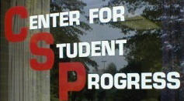
Center For Student Progress
What is it?
  A free tutoring center for all students struggling in a variety of classes, such as: accounting, engineering, biology, history, chemistry, physics, economics, psychology, etc.
Services Offered:
  Regularly scheduled and individual group sessions
  Independent study materials
  Computer assisted instruction
  Review sessions for exams

Slide 22
When To Refer a Student to CSP?
If a student is not satisfied with their progress
If a student is not understanding the concepts
If a student needs practice in organizing information
If a student needs reinforcement to improve their confidence
If a student needs help in developing a good problem-solving strategy
If a student would like another point of view or another explanation of the major concepts
If a student would like help in reviewing for exams

Slide 23
Center for Student Progress Contact Information
If you need additional assistance, stop at the Center for Student Progress/Tutorial Services
  Monday - 8:00 am - 7:00 pm
  Tuesday - Friday 8:00 am - 5:00 pm
http://web.ysu.edu/csp

Slide 24

Starfish
Starfish is a tool designed to facilitate communication between instructors, advisors and support services (Center for Student Progress)
Instructors can use Starfish to:
Respond to university progress surveys,
Maintain a student folder of notes and emails,
Record attendance,
Make referrals by raising a flag or give encouragement for student success.
Fall 2012: 1,506 intro-level classes using Starfish. The response rate was 31%. Approximately 800 concerns were raised, and all have been addressed by the Center for Student Progress.
Starfish Training Manual - http://web.ysu.edu/gen/ysu_generated_bin/documents/basic_module/Starfish__Instructor_Training_Manual1.pdf

Slide 25
Disability Services – Offered by the Center for Student Progress
What is Disability Services?
  Disability Services provides assistance for students, faculty and staff with disabilities.
How does a student become registered through Disability Services?
  Have a documented physical, psychological, and/or learning disability
  Documentation Requirements - http://web.ysu.edu/gen/ysu/Documentation_Requirements_m1703.html
Key Points:
  Unlike high school, It is the student's responsibility to ask for assistance and learn the services that exist on the campus for that assistance.
  There are not special classes for students with disabilities; students with disabilities are in classes will all other students.
  Course work requirements are the same for all students

Slide 26
CSP Disability Services
Services for students with documented disabilities may include but are not limited to the following:
  Early registration
  Testing and classroom accommodations
  Escort Services
  Limited loan of adaptive equipment
  Books on tape/e-text
  Sign language interpreters
  Notetakers for students who are blind, hard of hearing or physically unable to write

Slide 27
CSP Disability Services
Can obtain a liaison with YSU departments and local agencies
Cushwa Hall Lounge for students with severe disabilities
Adaptive technology computer work stations, which contain programs such as Jaws 4.0, Open Book and Zoom Text, are available on the fourth floor of the Maag Library at YSU
  Computers at the CSP Disability Services also have the same assistive software on them.

Slide 28
CSP Disability Services
Located at 275 Fifth Avenue
Office Phone: 330-941-1372
Office Hours:
  Monday – Friday - 8:00 a.m. - 5:00 p.m.
Appointments scheduled as needed
Director:
  Gina McGranahan - glmcgranahan@ysu.edu
http://web.ysu.edu/gen/ysu/Disability_Services_m695.html

Slide 29

Reading and Study Skills Center
The Reading and Study Skills (R&SS) Center is an academic as well as a service-oriented division of the Counseling Department in the College of Education .
What is the Reading and Study Skills Center used for?
  To provide a variety of strategies for improving reading and studying.
  To encourage students to choose study techniques appropriate to their needs.
  To help students understand that building reading and study skills provides high returns for their investment in study time.
  To help students improve performance in academic classes.

Slide 30
Reading and Study Skills Center
The RSS Center will help students improve:
  Reading skills
  Test taking skills
  Study skills
  Organizational skills
  Computer assisted instruction
  Preparation for standardized exams
YSU students may take advantage of services through:
  Academic classes
  Self-referral tutoring--individual tutoring with a trained Peer Tutor
  Workshops presented throughout the semester on a variety of topics

Slide 31
Reading and Study Skills Center Contact Information
Located in the Maag Library - Room 154 (lower level)
Telephone:
  330-941-3099
E-mail address:
  rdgstudyskillsctr@ysu.edu
Coordinator:
  Dr. Karen Becker
http://web.ysu.edu/rdgstudyskills/

Slide 32
Math Assistance Center
The Mathematics Assistance Center [MAC] is an academic support service which is integrated with the Department of Mathematics & Statistics.
The MAC operates on a walk-in basis; no appointment is necessary.
Services include providing tutorial assistance to any student currently enrolled in one or more mathematics courses served by the MAC (tutorial assistance is limited to these courses).
The MAC gives assistance to all math classes from 1500 to 3717

Slide 33
Math Assistance Center Location
Lincoln Building – Room 408
Email: mathassist@math.ysu.edu
  You can e-mail your math questions to this address and get an answer through e-mail.
Phone: (330) 941-3274
http://web.ysu.edu/gen/stem/Mathematics_Assistance_Center_m532.html

Slide 34

The Writing Center
The Writing Center's mission is to help students become more independent, confident and successful writers.
  Consultations for individuals or small groups
  Assessment of writing strengths and weaknesses
  Guidance for essays, lab reports, history papers, résumés and other writing projects in all disciplines
  Help with documentation in APA, MLA, Chicago and other styles
  Preparation advice for writing portions of standardized tests, including the GRE, GMAT, LSAT, etc.
  Instruction in linguistics
  Tutoring for ESL students
  Sessions for peer reviews

Slide 35
Writing Center
Writing Center consultants can help with more than just English papers. Students can bring in writing assignments received from other disciplines.
  History papers
  Lab reports
  Résumés and cover letters
  Linguistics assignments
  PowerPoint presentations
  Speeches
  Microsoft Office programs
  Job or graduate school application essays and more

Slide 36
The Writing Center
Locations and Hours
The Writing Center has three physical locations at:
  Maag Library - Lower Level - Room 171 - 330-941-3055
    Monday–Thursday: 9 a.m.–5 p.m.
    Friday: 10:30 a.m.–1:30 p.m.
    Sunday: 3 p.m.–6 p.m.
  Stambaugh Stadium - Room 1097 - 330-941-1921
    Monday: 10 a.m.–noon
    Tuesday & Thursday: 12:30 p.m.–2 p.m.
    Wednesday: noon–2p.m.
  Metro College at Southwoods - 330-941-2465
    Mondays & Wednesdays: 5 p.m.–6p.m.
    Tuesdays: 5–8 p.m.

Slide 37
The Writing Center
Contact Information
Appointments, walk-ins and online consultations are available, and clients are permitted either two walk-ins or an appointment and a walk-in per week.
Email:
  wcenter@ysu.edu
Phone:
  (330) 941-3055
http://web.ysu.edu/writingcenter/

Slide 38
Career Services
Career and Counseling Services also helps students who are seeking assistance in mapping out and building their future.
Career services gives pointers to students in each stage of their education so that they can stay on track and be prepared for the world of work when they graduate.
Location:
  Office of Career and Counseling Services, Jones Hall – Room 1034
Hours:
  Mon. through Fri. 8:00 a.m. – 5:00 p.m.
Phone:
  (330) 941-3515
Website:
  http://web.ysu.edu/careerservices/

Slide 39
Other Issues
FERPA – Federal law that governs student records and privacy.
  You can share information with individuals on campus (resources discussed) who are responsible for the care/well being of students.
Confidentiality
  You should not promise to keep secret if a student shares that they will harm themselves or others.
  When sharing concerns with others consider how it will support the well-being of the student vs. gossip.
  Consider if/when you share information with another faculty if it will negatively impact how they view/treat the student in their class.

Slide 40
YSU Student Code of Conduct
http://ysu.edu/thecode.pdf
Students, as members of the University community, shall have the following responsibilities which are inherent in the basic rights delineated above:
1. To maintain standards of academic performance as established by their faculty.
2. To be responsible for acting in such a manner as to ensure other students the rights declared in Section B. of this article.
3. To be responsible for their actions with respect to, and to follow, all University regulations and policies.
4. To be responsible for their actions with respect to provisions of local, state, and federal law.
5. To conduct themselves in a manner which helps to create and maintain a learning atmosphere in which the rights, dignity, and worth of every individual in the University community are respected.
6. To have in their possession a valid University Identification Card when on University premises.
7. To be responsible for adhering to the Drug-Free Environment Policy.
8. To ensure adherence to all University Board of Trustees policies that apply to students. (pg. 6-7)

Slide 41
YSU Student Code of Conduct
1. Acts of dishonesty, include, but are not limited to: Academic Dishonesty , Non-Academic Dishonesty
2. Disruption or obstruction of teaching, research, administration, student conduct proceedings, other University activities, including its public-service functions on or off campus, or other authorized non-University activities, when the act occurs on University premises.
3. Participation in an on-campus or off-campus demonstration, riot, or activity which disrupts the normal operations of the University and/or infringes on the rights of other members of the University community; leading or inciting others to disrupt scheduled and/or normal activities within any campus building or area.
4. Obstruction of the free flow of pedestrian or vehicular traffic on University premises or at University sponsored or supervised functions.
5. Failure to comply with directions and/or oral or written instructions which are given by any University official, student, faculty member, or staff who is acting in an official University capacity and/or failure to identify oneself to these persons when requested to do so.
6. Failure to meet all financial obligations to the University.
7. Violation of published University policies, rules, or regulations including those available electronically on the University website.
8. Physical abuse, verbal abuse, threats, intimidation, harassment, stalking, bullying and/or coercion which endangers or tends to endanger the safety, health, or life of any person (including self).
9. Sex Discrimination which includes sexual harassment and sexual violence. See Article. IX.
10. Hazing, defined as an act which endangers the mental or physical health or safety of a student, or which destroys or removes public or private property, for the purpose of initiation, admission into, affiliation with, or as a condition for continued membership in a group or organization.
11. Conduct which is disorderly, disruptive, or indecent; breach of peace; or aiding, abetting, or procuring another person to breach the peace on University premises or at functions sponsored, or participated in, by the University or members of the University community.
12. Unauthorized use of electronic or other devices to make an audio or video record of any person while on University premises without his/her prior knowledge, or without his/her effective consent when such recording is likely to cause injury or distress, except as otherwise permitted by law.

Slide 42
YSU Student Code of Conduct
13. Unauthorized distribution or dissemination of an audio or video recording or photograph of any person without his or her prior knowledge or consent, even if the audio or video recording or photograph originally had been produced with the person’s consent.
14. Gambling or wagering of any form except as expressly permitted by law and/or University regulations.
15. Attempted or actual theft, including possession of stolen property.
16. Any action which damages or tends to damage property of the University, or property of a member of the University community, or other personal or public property, on or off campus.
17. Unauthorized possession, duplication, or use of keys to any University premises, or unauthorized entry to or use of University premises.
18. Theft or other abuse of information technology and resources, including, but not limited to:
19. Use, possession, manufacturing, or distribution of marijuana, heroin, narcotics, or other controlled substances in either refined or crude form, including the use of drug-related paraphernalia, except as expressly permitted by law and/or under the direction of a licensed physician. No student shall sell or give drugs to any other person.
20. Public intoxication or use, possession, manufacturing, or distribution of alcoholic beverages, except as expressly permitted by law and/or University regulations. Alcoholic beverages may not, in any circumstance, be used by, possessed by, or distributed to any person under twenty-one (21) years of age.
21. Illegal or unauthorized possession of firearms, fireworks, explosives, other weapons, or dangerous chemicals on University premises or use of any such item, even if legally possessed, in a manner that harms, threatens, or causes fear to others.
22. Entering false fire alarms, bomb threats, or tampering with fire extinguishers, alarms, smoke detectors, or other safety equipment.
23. Abuse of the student conduct system, including, but not limited to:
24. Violation of federal, state, or local law.

Slide 43
YSU References
YSU Career Services - http://web.ysu.edu/careerservices/
YSU Center for Student Progress – http://web.ysu.edu/csp
YSU Code of Conduct - http://ysu.edu/thecode.pdf
YSU Counseling Services - http://web.ysu.edu/gen/ysu/Mental_Health_Counseling_m924.html
YSU Disabilities Service Center - http://web.ysu.edu/gen/ysu/Disability_Services_m695.html
YSU Math Assistance Center - http://web.ysu.edu/gen/stem/Mathematics_Assistance_Center_m532.html
YSU Reading & Study Skills Center - http://web.ysu.edu/rdgstudyskills/
YSU Starfish - http://web.ysu.edu/gen/ysu_generated_bin/documents/basic_module/Starfish__Instructor_Training_Manual1.pdf
  YSU Threat Assessment Team - http://web.ysu.edu/stat
YSU Writing Center - http://web.ysu.edu/writingcenter/

Slide 44
References
Leaming, D. R. (2007). Academic leadership (2nd Ed.) San Francisco, CA: Wiley.
Hara, B. (2012). Disruptive student behavior (t-shirt slogan edition). The Chronicle of Higher Education. https://chronicle.com/blogs/profhacker/disruptive-student-behavior-t-shirt-slogan-edition/23766
Bart, M. (2012). Dealing with difficult students and other classroom disruptions. Faculty Focus: Higher Ed Teaching Strategies from Magna Publications. Retrieved from: http://www.facultyfocus.com/articles/effective-classroom-management/dealing-with-difficult-students-and-other-classroom-disruptions/
Brewer, E. W., & Burgess, D. N. (2005). Professor’s role in motivating students to attend class. Journal of Industrial Teacher Education, 42(3). Retrieved from: http://scholar.lib.vt.edu/ejournals/JITE/v42n3/brewer.html
Christophel, D. M., & Gorham, J. (1995). A test-retest analysis of student motivation, teacher immediacy, and perceived sources of motivation and demotivation in college classes. Communication Education, 44, 292-306.
Gorham, J., & Millette, D. M. (1997). A comparative analysis of teacher and student perceptions of sources of motivation and demotivation in college classes. Communication Education, 46, 245-261.
Hollingsworth, K. R., Dunkle, J. H., & Douce, L. (2009). The high-risk (disturbed and disturbing) college student. New Directions for Student Services, 128, 37-54.
Kuhlenschmidt, S. L., & Layne, L. E. (1999). Strategies for dealing with difficult behavior. New Directions for Teaching and Learning, 77, 45-57.
Sorcinelli, M. D. (1994). Dealing with troubling behaviors in the classroom. In K.W. Prichard & R.M. Sawyer (Eds.) Handbook of college teaching: Theory and applications, 365-373.
Strage, A. (2008). Traditional and non-traditional college students’ descriptions of the “ideal” professor and the “ideal” course and perceived strengths and limitations. College Student Journal, 42(1), 225-231.
Thompson, B . R., & Geren, P. R. (2003). Classroom strategies for identifying and helping college students at risk for academic failure. College Student Journal, 36(3), 398-402.
Tobin, T. J. (2001). Dealing with problem students and faculty. Online Journal of Distance Learning Administration, 4(3), 1-26.
Wingert, D., & Molitor, T. (2009). Best practices: Preventing and managing challenging classroom situations. Currents in Teaching and Learning, 1(2), 4-18.

